Slide 1
Tech Town 21st
By: Brandon Pham

Slide 2
Overview
Description: I will do a blog about things in the game world and technology.
Blogging on Technology
Research Required: I will search for websites that talk and review stuff about technology.
Then read some of it and then write about it on my blog.

Slide 3
Challenges
In the very beginning I had to learn to use word press.
Then finding interesting things on technology to write about.
Trying to stay on schedule on how many blogs I do.
Learning how to use word press was easy, then my favorite thing was using Zemanta.
It depended on what I wrote because some times on the websites there was nothing interesting.

Slide 4
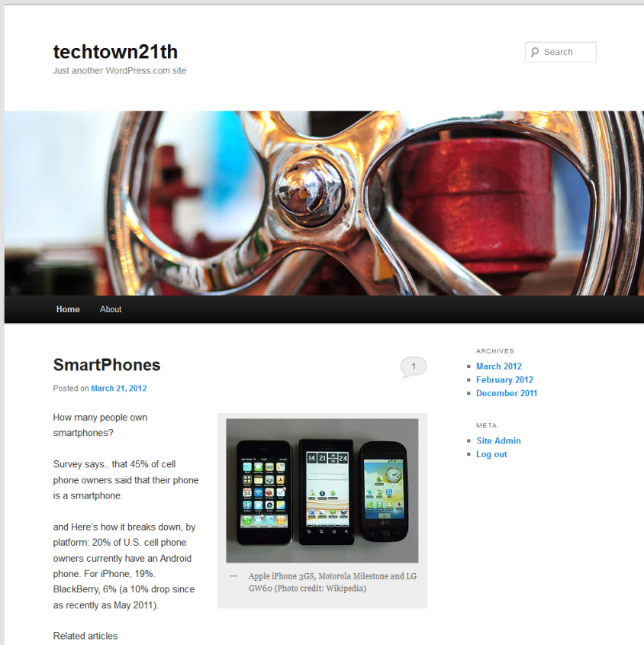
Webpage
http://techtown21th.wordpress.com/

